Slide 1
Cloud Programming Model: Server-less Computing
CE-408
Safia Baloch

Slide 2
Google App Engine/Amazon EC2
Eight issues to be addressed in setting up an environment for cloud users.
Redundancy for availability, so that a single machine failure doesnt take down the service.
Redundancy ensures that multiple copies of a service or data are maintained to prevent downtime in case of hardware or software failure. This way, if one machine fails, others can take over, ensuring continuous service availability.
Geographic distribution of redundant copies to preserve the service in case of disaster.
Distributing redundant copies across multiple geographic locations protects against regional disasters (e.g., earthquakes, floods). This ensures that even if one data center goes offline, the service can still operate from another location.
Load balancing and request routing to efficiently utilize resources.
Load balancing distributes incoming traffic across multiple servers to prevent overloading any single resource. Efficient request routing ensures that users are directed to the nearest or least busy server, optimizing performance and resource utilization.
Auto-scaling in response to changes in load to scale up or down the system.
Auto-scaling dynamically adjusts the number of active servers based on real-time demand, scaling up during peak loads and down during low usage. This ensures optimal resource usage and cost efficiency while maintaining performance.

Slide 3
Google App Engine/Amazon EC2
Monitoring to make sure the service is still running well.
Monitoring tools track system performance, uptime, and resource usage to detect and resolve issues proactively. This ensures the service runs smoothly and meets performance benchmarks.
Logging to record messages needed for debugging or performance tuning.
Logging records system events, errors, and performance metrics for analysis. These logs are crucial for debugging issues, identifying bottlenecks, and optimizing system performance.
System upgrades, including security patching
Regular system upgrades and security patches are essential to protect against vulnerabilities and ensure the latest features are available. Automated tools can help streamline this process without disrupting service.
Migration to new instances as they become available
Migrating to new instances involves moving workloads to updated or more efficient hardware/software without downtime. This ensures the system remains modern, secure, and capable of handling evolving demands.

Slide 4
Server-less Cloud
Cloud user simply writes the code and leaves all the server provisioning and administration tasks to the cloud provider.
Key Idea: “No Server management, pay-per-execution, and automatic scaling”
Traditional Models:
1: IaaS, EC2, server
2: PaaS, code and server
3: Serverless: AWS lambda, triggered by events.

Slide 5
Serverless
While cloud functions packaged as FaaS (Function as a Service) offerings (AWS lambda, GCF, IBM Cloud Function, Azure Functions) represent the core of serverless computing,
cloud platforms also provide specialized serverless frameworks that cater to specific application requirements as BaaS (Backend as a Service) offerings.
Serverless Computing = FaaS +BaaS

Slide 6
Key Concepts
Event-driven Architecture
Functions are triggered by events
Statelessness
Functions are ephemeral and stateless
How to preserve function state?
Scaling
Automatic scaling from zero to thousands of instances
FaaS
Core component: Deploy function not server

Slide 7
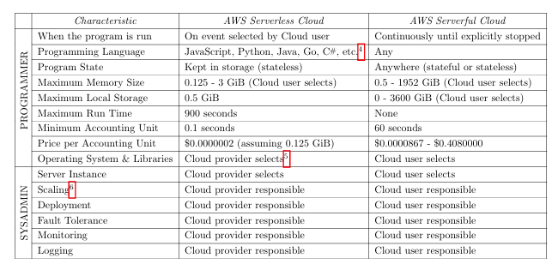
Emergence of Server-less Computing
summary of differences between serverless and the traditional approach.

Slide 8
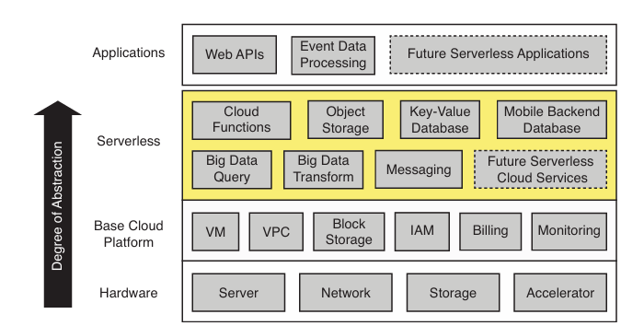
There are three critical distinctions between serverless and serverful computing
Decoupled computation and storage.
Executing code without managing resource allocation.
Paying in proportion to resources used instead of for resources allocated.
The serverless layer sits between applications and the base cloud platform, simplifying cloud programming.
Cloud functions (i.e., FaaS) provide general compute and are complemented by an ecosystem of specialized Backend as a Service (BaaS) offerings such as object storage, databases, or messaging.
The base underlying base cloud platform includes virtual machines (VM), private networks (VPC), virtualized block storage, Identity and Access Management (IAM), as well as billing and monitoring.

Slide 9
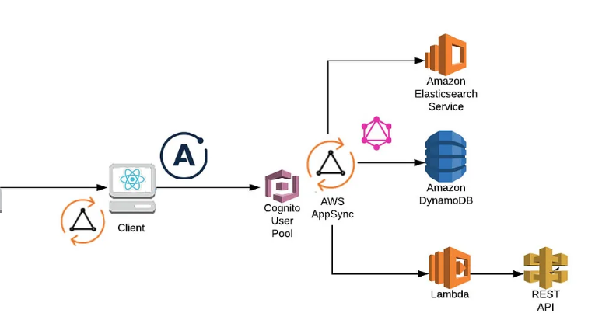

Slide 10
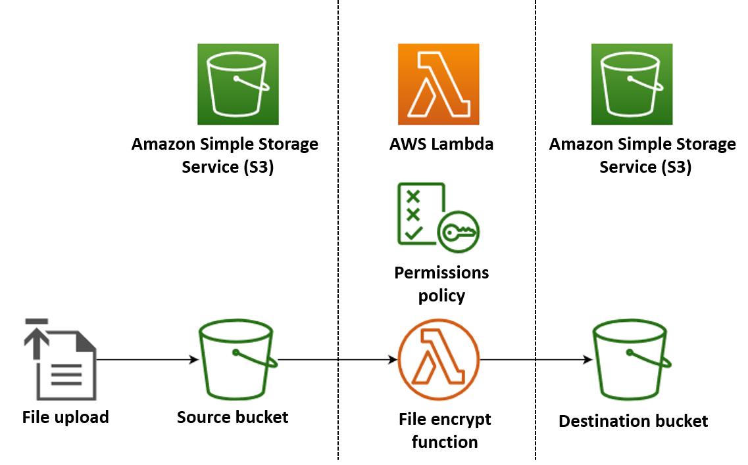
Serverless Apps
In this example, you create an app which automatically encrypts PDF files when they are uploaded to an Amazon Simple Storage Service (Amazon S3) bucket. To implement this app, you create the following resources:
An S3 bucket for users to upload PDF files to
A Lambda function in Python which reads the uploaded file and creates an encrypted, password-protected version of it
A second S3 bucket for Lambda to save the encrypted file in

Slide 11
Limitations of today’s serverless computing Platforms
Hostel Task

Slide 12
Discuss
How does serverless computing relates to Kubernetes?

